Slide 1

Indian institute of information technology bhagalpur
Summer Internship Project
On
Flask Chat Application(U Chat)
By
Abhishek Kumar(170101003)
Himanshu Ranjan(170101017)

Slide 2
Agenda for Today’s Presentation
Introduction about project
Tools required
Implementation
Working
Future Aspects
Conclusion

Slide 3
introduction
Chat refers to the process of communicating, interacting and/or exchanging messages over the Internet. It involves two or more individuals that communicate through a chat-enabled service or software. Chat may be delivered through text, audio or video communication via the Internet.
The chat application we have made is more like a chat room, rather than a peer to peer chat. So, this means that multiple users can connect to the chat server and send their messages. Every message is broadcasted to every connected chat user.

Slide 4
Tools required
Python
Flask
Flask-SocketIO
Mongo DB

Slide 5
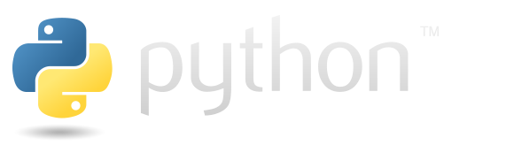
Python is an interpreted, high-level and general-purpose programming language. Python's design philosophy emphasizes code readability with its notable use of significant whitespace. Its language constructs and object-oriented approach aim to help programmers write clear, logical code for small and large-scale projects.

Slide 6

Flask is a micro web framework written in Python. It is classified as a microframework because it does not require particular tools or libraries. It has no database abstraction layer, form validation, or any other components where pre-existing third-party libraries provide common functions. However, Flask supports extensions that can add application features as if they were implemented in Flask itself. Extensions exist for object-relational mappers, form validation, upload handling, various open authentication technologies and several common framework related tools.

Slide 7
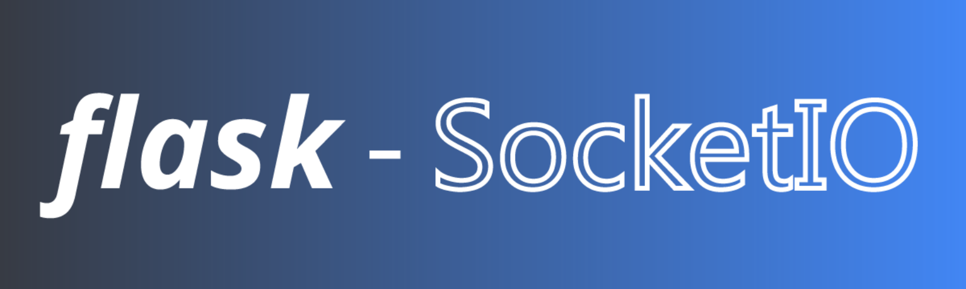
Socket.IO enables real-time bidirectional event based communication. It works on every platform, browser or device, focusing equally on reliability and speed.
Flask-SocketIO gives Flask applications access to low latency bi-directional communications between the clients and the server. The client side application can use any of the SocketIO official clients libraries in Java script, C++, Java and Swift, or any compatible client to establish a permanent connection to the server.

Slide 8
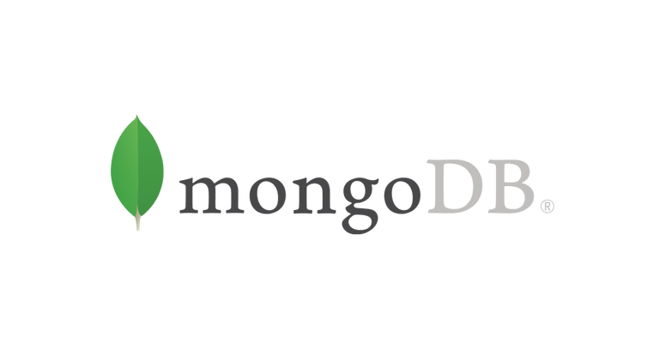
MongoDB is a cross-platform document-oriented database program. Classified as a NoSQL database program, MongoDB uses JSON-like documents with optional schemas. MongoDB is developed by MongoDB Inc. and licensed under the Server Side Public License (SSPL).
MongoDB is an open-source document database and leading NoSQL database. MongoDB is written in C++.

Slide 9
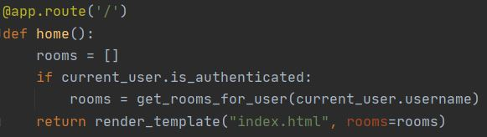
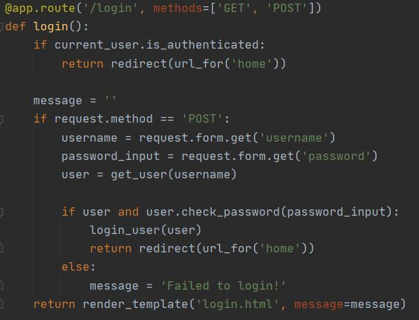
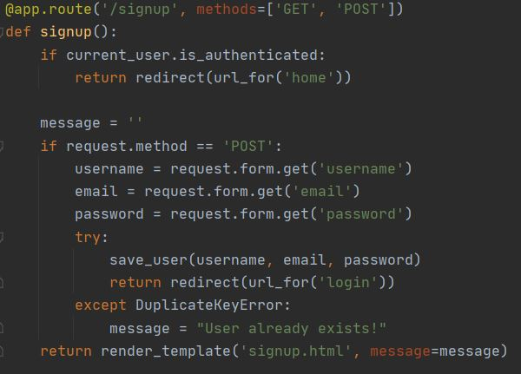
Implementation
Home
Signup
Login

Slide 10
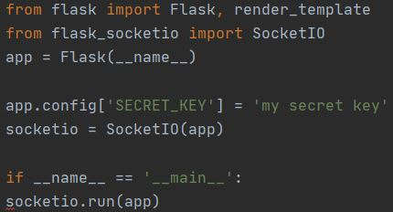
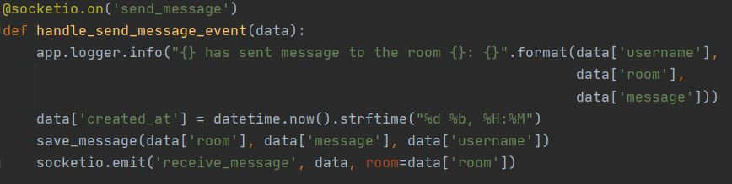
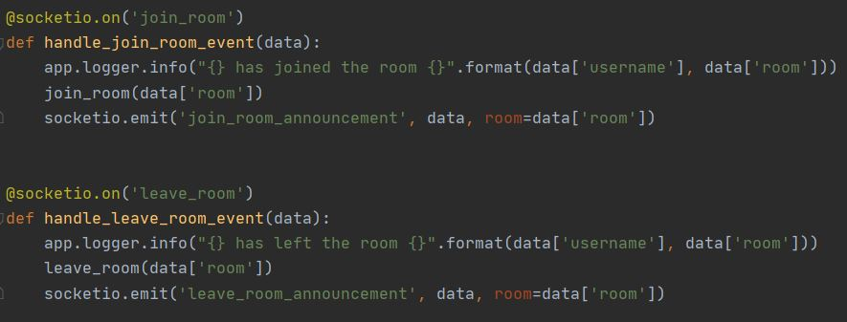
Server Initilization
Join & Leave
Send Messages

Slide 11
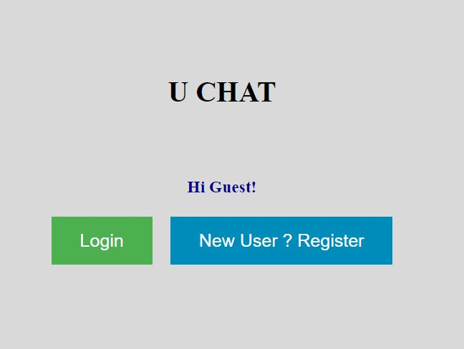
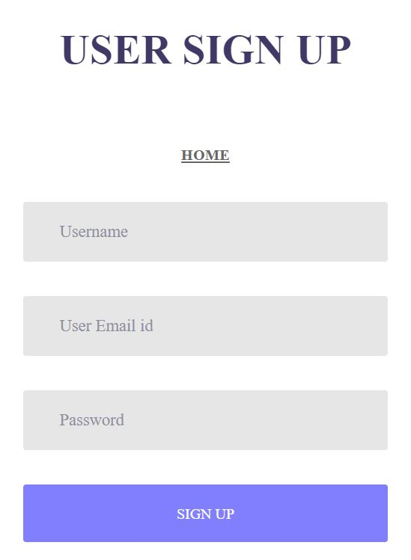
working
Home
Register User

Slide 12
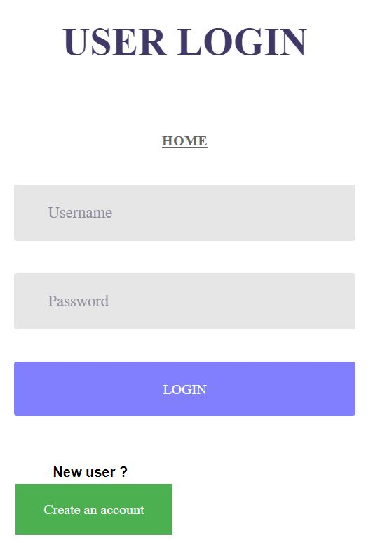
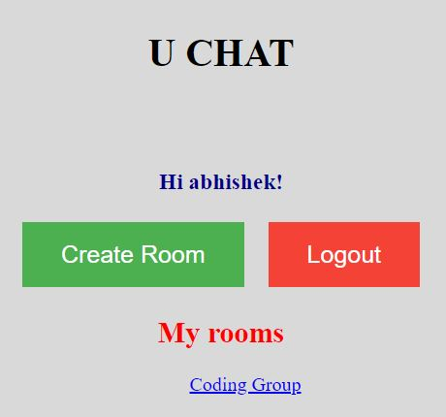
Login User
User Dashbord

Slide 13
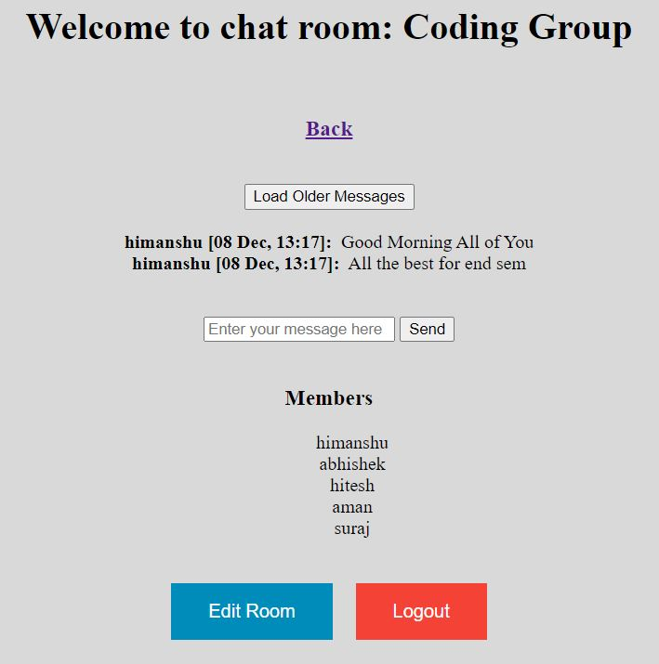
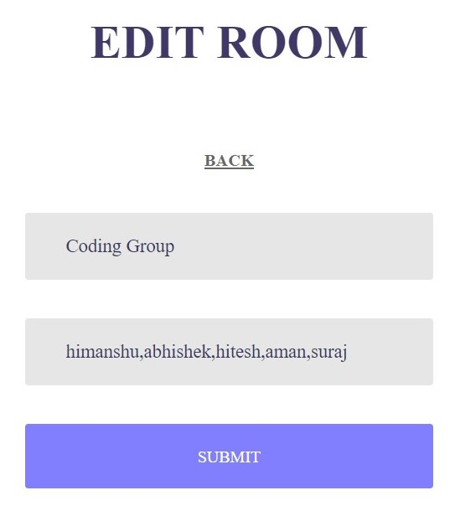
Login User
Edit Room

Slide 14
Future aspects
Rather than text, image and video transfer can be added in this chat application.
Increasing the effectiveness of the application by providing Voice Chat.
Android app can be developed for easier use.

Slide 15
Conclusion
Overall, we would class this project as a success. Everything that was outlined in the early stages of the project was achieved and a lot of extra features were also added.
In this project we have used the basics of networking in python. We also learned how to make a GUI for our application. This project teaches us how to create a basic chat application by creating GUI using flask and socketio.

Slide 16

Thank You!

